Slide 1

Spatial News
LITERATURE REVIEW
Localization of
incidents within a community
Callie Wentling
Professor Marco Painho

Slide 2
Literature Review
Smart cities
Open Source
Fundamental concepts
Geospatial search tools
Geoportal
Definition of terms
Map algebra
AirBnB
UberEats
Facebook events
GoogleMaps
Idealista
Lisboa Aberta
PPGIS
Licensing options
Geotagging
Microparticipation
Open WebGIS formats
Gazetteers
Community
Internalization and localization
Sense of place
Design
Data types
Spatial enablement
Visualization
GeoBlog
Interface
Build
Search/filter
Hosting
WebGIS
Front end: leaflet, open layers, HTML
News industry
Open/free tools
Database: PostGIS, PostgreSQL
QGIS cloud
Historical
Data prep: QGIS
Localized News
Leaflet
Current
Backend
Automatic extraction
Lizmap
Mass customization
Portugal
Python (shapely, geopandas, gdal, pyproj)
Geodjango
geo server
Público
Eco SAPO
MAGG
MapServer
InYourArea
NextDoor
Geomajas

Slide 3
References
[1] Greg G. Brown and David V. Pullar. An evaluation of the use of points versus polygons in pub-
lic participation geographic information systems using quasi-experimental design and Monte Carlo
simulation. International Journal of Geographical Information Science, 26(2):231–246, 2012.
[2] OpenStreetMap.
[3] Jennifer Evans-Cowley and Justin Hollander. The new generation of public participation: Internet-based participation tools. Planning Practice and Research, 25(3):397–408, 2010.
[4] Eric Fisher. Making the most detailed tweet map ever, dec 2014.
[5] Fabio Parasecoli and Mateusz Halawa. Rethinking the global table. In May Rosenthal and Catherine Flood, editors, Food: Bigger than the plate, pages 80–89. Victoria and Albert Museum, London, 2019.
[6] Devanjan Bhattacharya and Marco Painho. Location intelligence for augmented smart cities integrating sensor web and spatial data infrastructure (SmaCiSENS). GISTAM 2018 - Proceedings of the 4th International Conference on Geographical Information Systems Theory, Applications and Management, 2018-March(Gistam):282–289, 2018.
[7] Tiago H Moreira De Oliveira and Marco Painho. Open Geospatial Data Contribution Towards Sentiment Analysis Within the Human Dimension of Smart Cities. In A Mobasheri, editor, Open Source Geospatial Science for Urban Sudies., pages 75–95. Springer International Publishing, 2021.
[8] Alexandria Digital Library Gazetteer — UCSB Library, 2019.
[9] The Denver Post, 2020.
10] Ben Shneiderman. The Eyes Have It: A Task by Data Type Taxonomy for Information Visualizations. Technical report, University of Maryland, College Park, jul 1996.
11] Jayna McQueen Baker, Gabriel Huddleston, and Erin Atwood. The Map as Object: Working Beyond Bounded Realities and Mapping for Social Change. Educational Research for Social Change, 8(1):13–152, 2019.
[12] ESRI. What is LocateXT.
[13] Michelle Rial. Am I overthinking this? Over-answers life’s questions in 101 charts. Chronicle Books, San Francisco, United Sates, aug 2019.
[14] Massey D. A Global Sense Of Place. Marxism Today, June(June):24–29, 1991.
[15] Sabine Witschas. Cross-border mapping-Geodata and Geonames. Technical report, 2004.
[16] Jerry Low. How to Host Your Own Website: Step-by-step Tutorial, sep 2020.
[17] Nader Afzalan, Thomas W. Sanchez, and Jennifer Evans-Cowley. Creating smarter cities: Considerations for selecting online participatory tools. Cities, 67(April):21–30, 2017.
[18] Greg G. Brown and David V. Pullar. An evaluation of the use of points versus polygons in pub-
lic participation geographic information systems using quasi-experimental design and Monte Carlo
simulation. International Journal of Geographical Information Science, 26(2):231–246, 2012.
[19] Ramiz Sami. Tools I recommend for building Geospatial Web Applications — by Ramiz Sami — The Startup — Medium, oct 2019.
[20] Reinout Kleinhans, Maarten Van Ham, and Jennifer Evans-Cowley. Using Social Media and Mo-
bile Technologies to Foster Engagement and Self-Organization in Participatory Urban Planning and
Neighbourhood Governance. Planning Practice and Research, 30(3):237–247, 2015.
[21] Karina Popova. Politicization of non-political events: A Geospatial Analysis of Twitter Content
During The 2014 FIFA World Cup. 2015.
[22] Cláudia Henriques, Pedro Marques Gomes, and Sı́lvia Marques Torres. OS MÉDIA NO PORTUGAL
CONTEMPORÂNEO: da ditadura à democ. Imprensa da Universidade de Coimbra, 35:19(2), 2019.
[23] Stig Hjarvard. The mediatization of culture and society. 2013.
[24] Ulrich Drepper, Jim Meyering, François Pinard, and Bruno Haible. GNU gettext tools, version 0.21.
Technical report, Free Software Foundation, Inc., jul 2020.
[25] Matt Makai. Deployment.
[28] Mark Fisher. Capitalist Realism: Is there no alternative? zero books, 2019.
[29] The Armed Conflict Location & Event Data Project, 2020.
[30] PÚBLICO, 2020.
[31] Albert Acedo, Tiago Oliveira, Mijail Naranjo-Zolotov, and Marco Painho. Place and city: toward a
geography of engagement. Heliyon, 5(8):e02261, 2019.
[32] Artur Jorge Abreu Varanda. Project ”ORACULO”: Extracting events from news streams and mining
their spatiotemporal patterns to support UN operations in the Central African Republic, 2020.
[33] Alberto Cairo. The truthful art: data, charts, and maps for communication. New Riders, San Fran-
cisco, 2016.
[34] C Giovando, N Vanraes, I Kanellopoulos, and G Saio. The nature-GIS portal: a gateway for accessing geospatial data on protected areas and nature preservation in Europe. Technical report, Warsaw, Poland, jun 2004.
[35] Prof Stéphane Roche. UrbComp2012 Paper10.pdf. 2012.
[36] Kostas Kampourakis. Television and the genetic imaginary. 2020.
[37] Jacob Granger. ”Mass customisation” of neighborhood data can help hyperlocal news become more sustainable, sep 2020.
[38] Elijah Meeks. 2019 Was the Year Data Visualization Hit the Mainstream, dec 2019.
[39] Richard Nordquist. Exonyms and Endonyms, jan 2018.
[40] Dean Hintz and Craig Hantke. How government agencies are integrating & delivering data for emergency response, 2020.
[41] Câmara Municipal de Lisboa. Boletim Municipal. Technical report, Câmara Municipal de Lisboa,
Lisboa, 2020.
[42] NGA: GNS Home.
[43] Ben Shneiderman. Data Visualization’s Breakthrough Moment in the COVID-19 Crisis, apr 2020.
[44] Katy Börner, Andreas Bueckle, and Michael Ginda. Data visualization literacy: Definitions, concep-
tual frameworks, exercises, and assessments. PNAS, 116(6):1857–1864, feb 2019.
[45] Yixuan Zhang, Kartik Chanana, and Cody Dunne. IDMVis: Temporal Event Sequence Visualization
for Type 1 Diabetes Treatment Decision Support. IEEE Transactions on Visualization and Computer
Graphics, 25(1):512–522, 2019.

Slide 4
Status: Momentum
Literature review is ongoing with no identified gaps in academic resources
Potential access to data from Público
Potential collaboration with a hyperlocal news project in Lisbon
Potential direct access to freguesia and Lisbon municipality level data
Sufficient data to build and test a V0 spatial database and input data tool

Slide 5
Status: Foreseen Challenges
Do all the identified areas need to be addressed in literature review vs. understood and applied appropriately (tool development)?
Do I have enough recent sources?
Unvalidated data model
No programming advisor
Readjustment of ideal toolset and prioritization to fit integration with a practical case study
Manual georeferencing of existing data streams
Intimidating development effort

Slide 6

Thank you!
Discussion
Address: Campus de Campolide, 1070-312 Lisboa, Portugal
Tel: +351 213 828 610 | Fax: +351 213 828 611

Slide 7
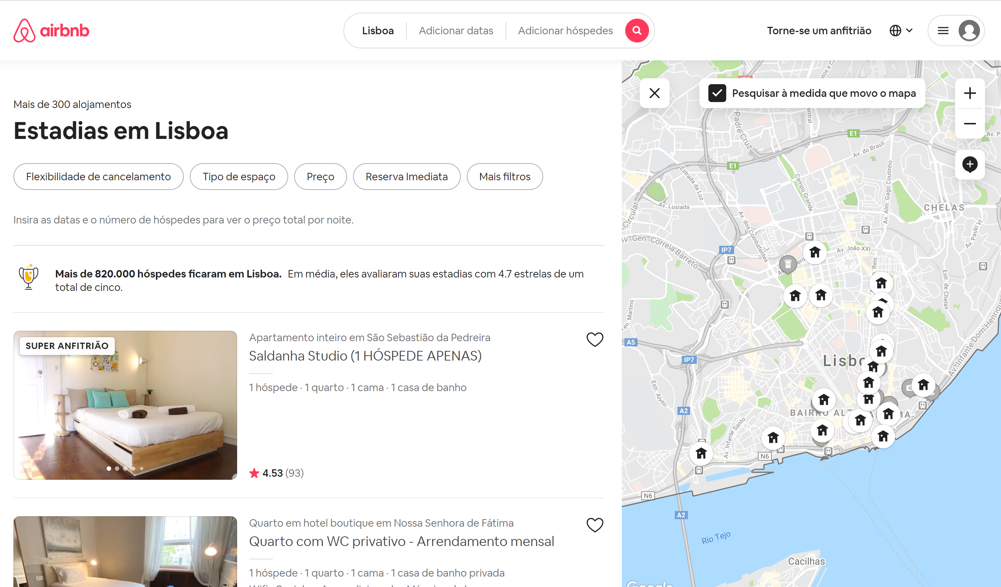
Framework: Situation
Notes:
We as digitally adept users are already trained to manipulate the spatial, temporal, and thematic attributes of databases such as AirBnB, GoogleMaps, UberEats, Glovo, Vagamundos, etc.

Slide 8
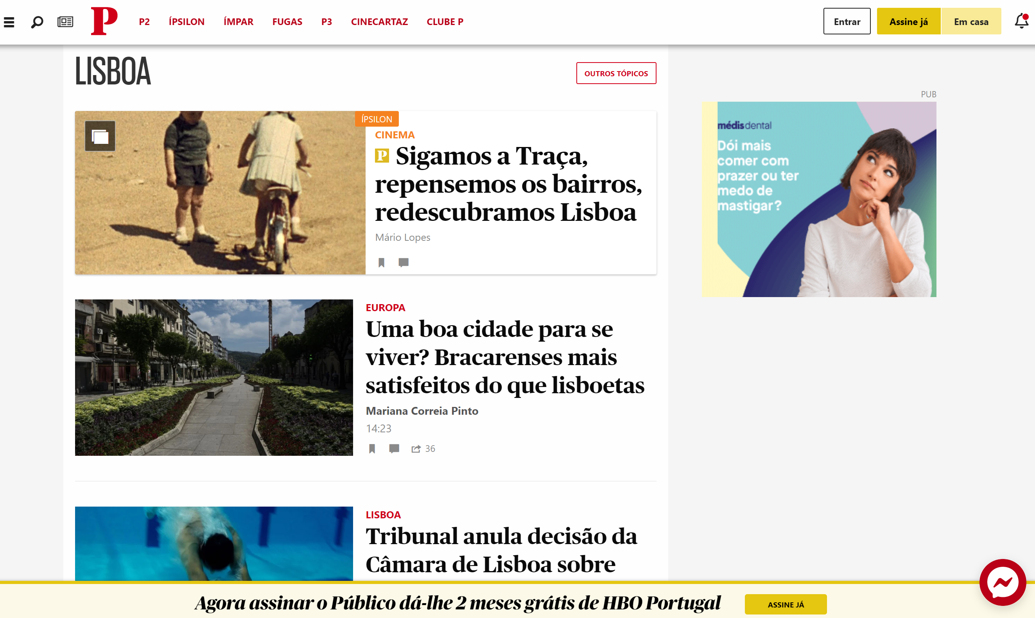
Framework: Status Quo
Notes:
This is noticeably absent from our news media. To search, we are provided only keywords or general categories. We cannot see distributions of news incidents for a given timeframe, and rarely is there even a context map to situate the potentially nuanced contents of a particular news story.
I propose to create a proof of concept webapp that tackles this void. The goal is to select a study area (Lisbon) and map the contents of news for a given study period, news source, and section (local). To do this, a suite of tools (input and manipulation) must be developed to investigate if this kind of product can provide additional citizen insight, stronger research resources, and/or official monitoring of an area to substantiate further development.
Because it is at a sub-city level, automatic extraction will likely not be appropriate to define location in many cases, and I anticipate that many areas will require custom definitions.

Slide 9
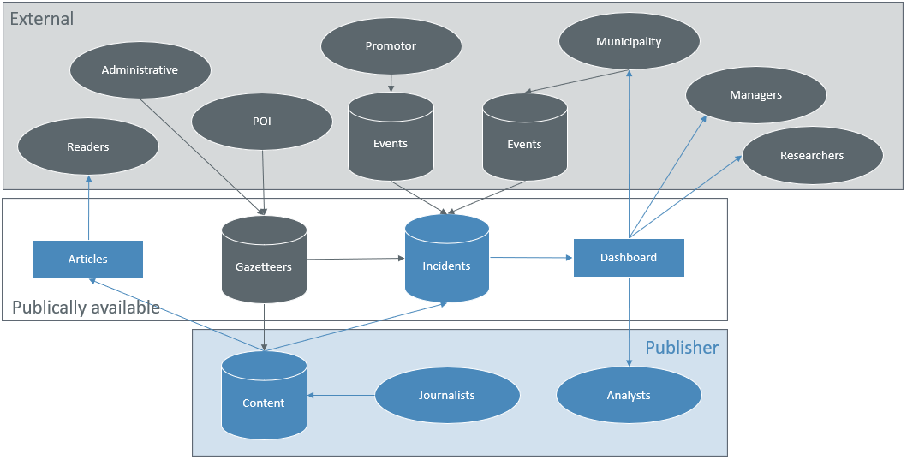
Framework: Data Flow

Slide 10
Hypothesis
Is there value in integrating a spatial component to news databases?
The association of place will provide a new dimension of understanding of incident distribution at a local level.
Publishers integrating spatial news may provide an improved user experience to readers, researchers, and monitors.

Slide 11
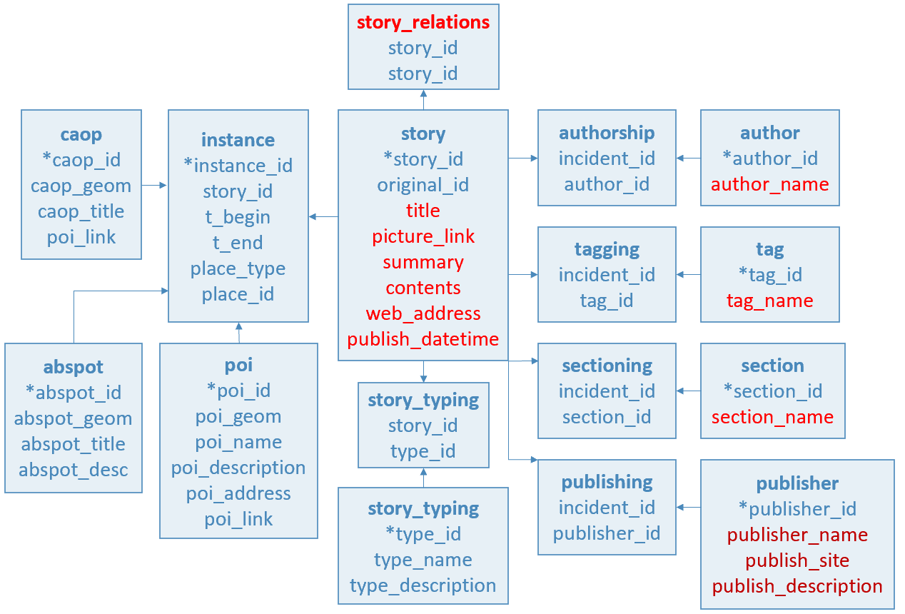
Objectives: Spatial DB of Incidents
Notes:
This is the current working data model. The items in red are expected to be provided by the news data sources.

Slide 12
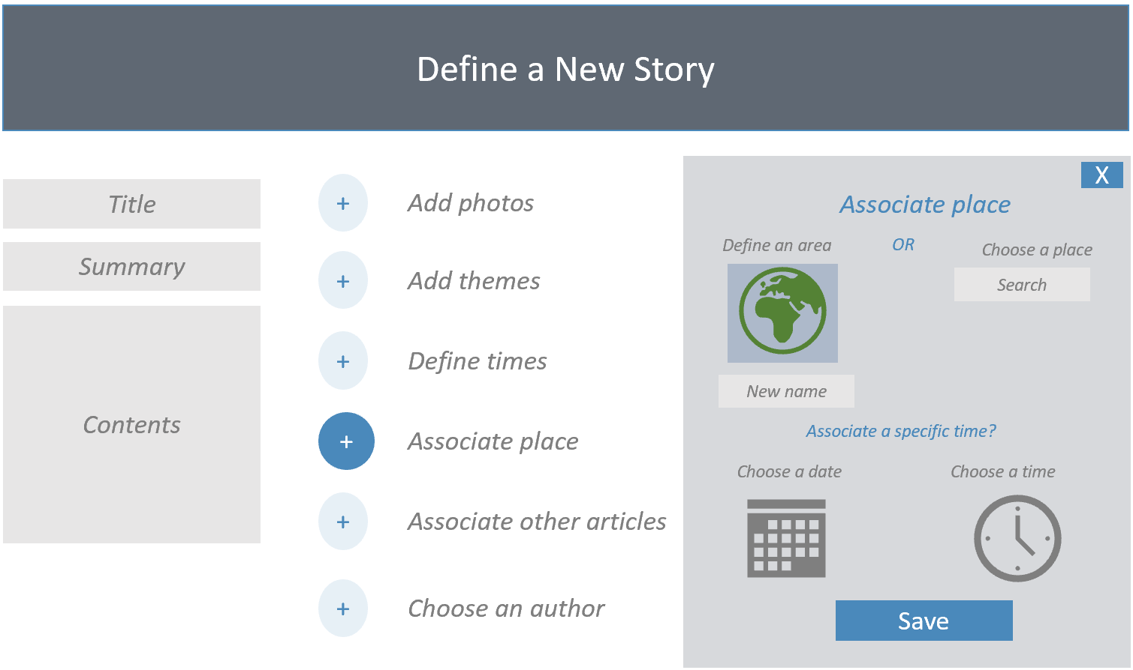
Objectives: Publisher Input Tool

Slide 13
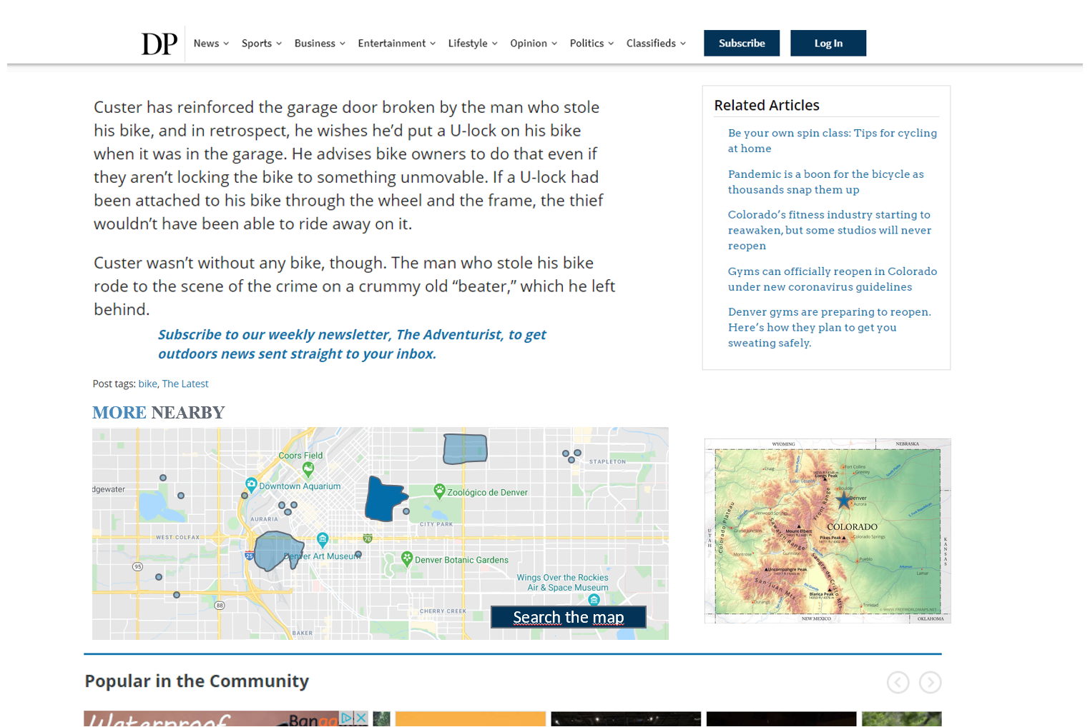
Objectives: Context Map

Slide 14
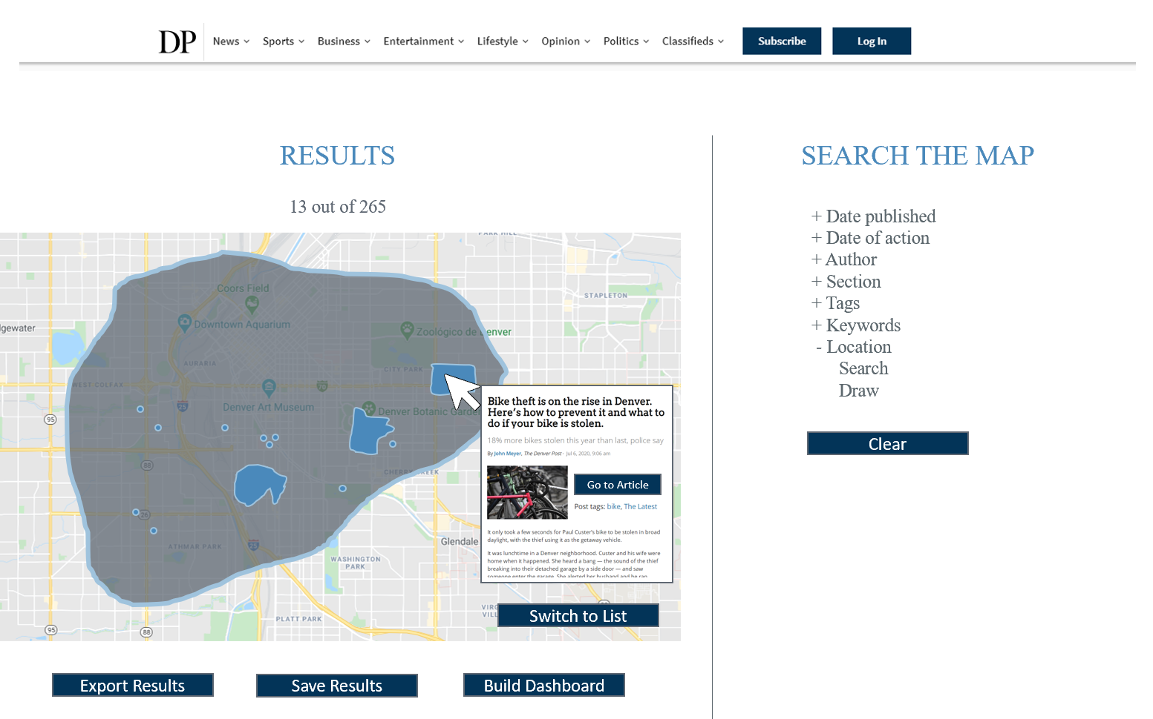
Objectives: Search Tool

Slide 15
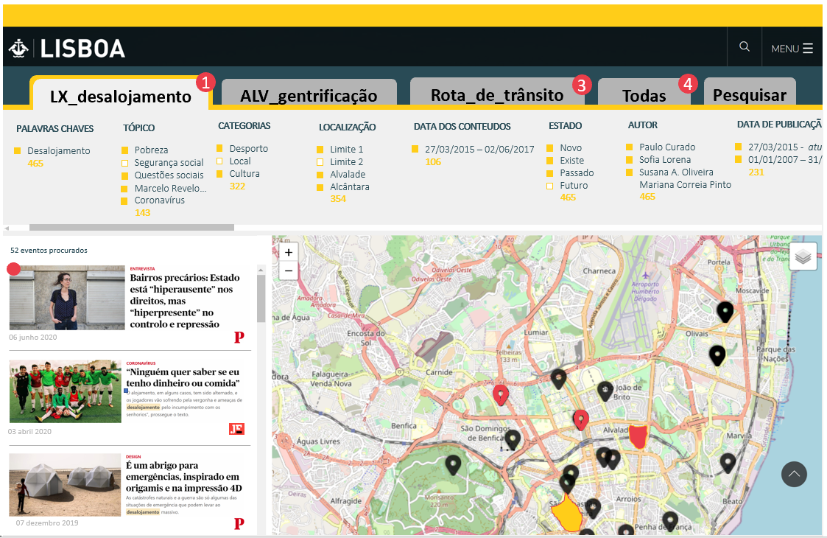
Objectives: Dashboard Tool

Slide 16
Methodology
Literature/resource review
Specification of products
Establish the development environment
Request/receive data
Establish incident DB
Load gazetteers, POI, admin boundaries
Develop and test tools
Translate and load content options
Migrate site to the server
Test among stakeholders
Document results and plan future development
Notes:
Incident DB: multiple spatial data types (point and polygons), multiple language options
Develop and test Input, Search, Context, and Dashboard tools

